Slide 1
TITLE:SALES DAHBROAD POWER BI PROJECT
Task 4 – Data Analyst Internship
Tool Used: Microsoft Power BI
Dataset: Sales / Financial Data (Kaggle)

Slide 2
📌 Introduction
Content:
This project focuses on building an interactive sales dashboard using Power BI. The goal is to help business stakeholders visualize key metrics like total sales, profit, discounts, and customer trends using a real-world dataset.
The dashboard is designed to provide insight into business performance, improve data-driven decisions, and ensure ease of use through interactivity and filters.

Slide 3
📈 Dashboard Features
The dashboard includes:
📌 KPI Cards: Total Sales, Profit, Quantity Sold, Discount %
📊 Visuals:
Line chart: Monthly sales trends
Bar chart: Sub-category sales & profit
Donut chart: Sales by product category
Table: Top 10 customers by sales
🎛 Slicers: Filters by month, sub-category, category
Design focused on clean layout, color consistency, and user interactivity.

Slide 4
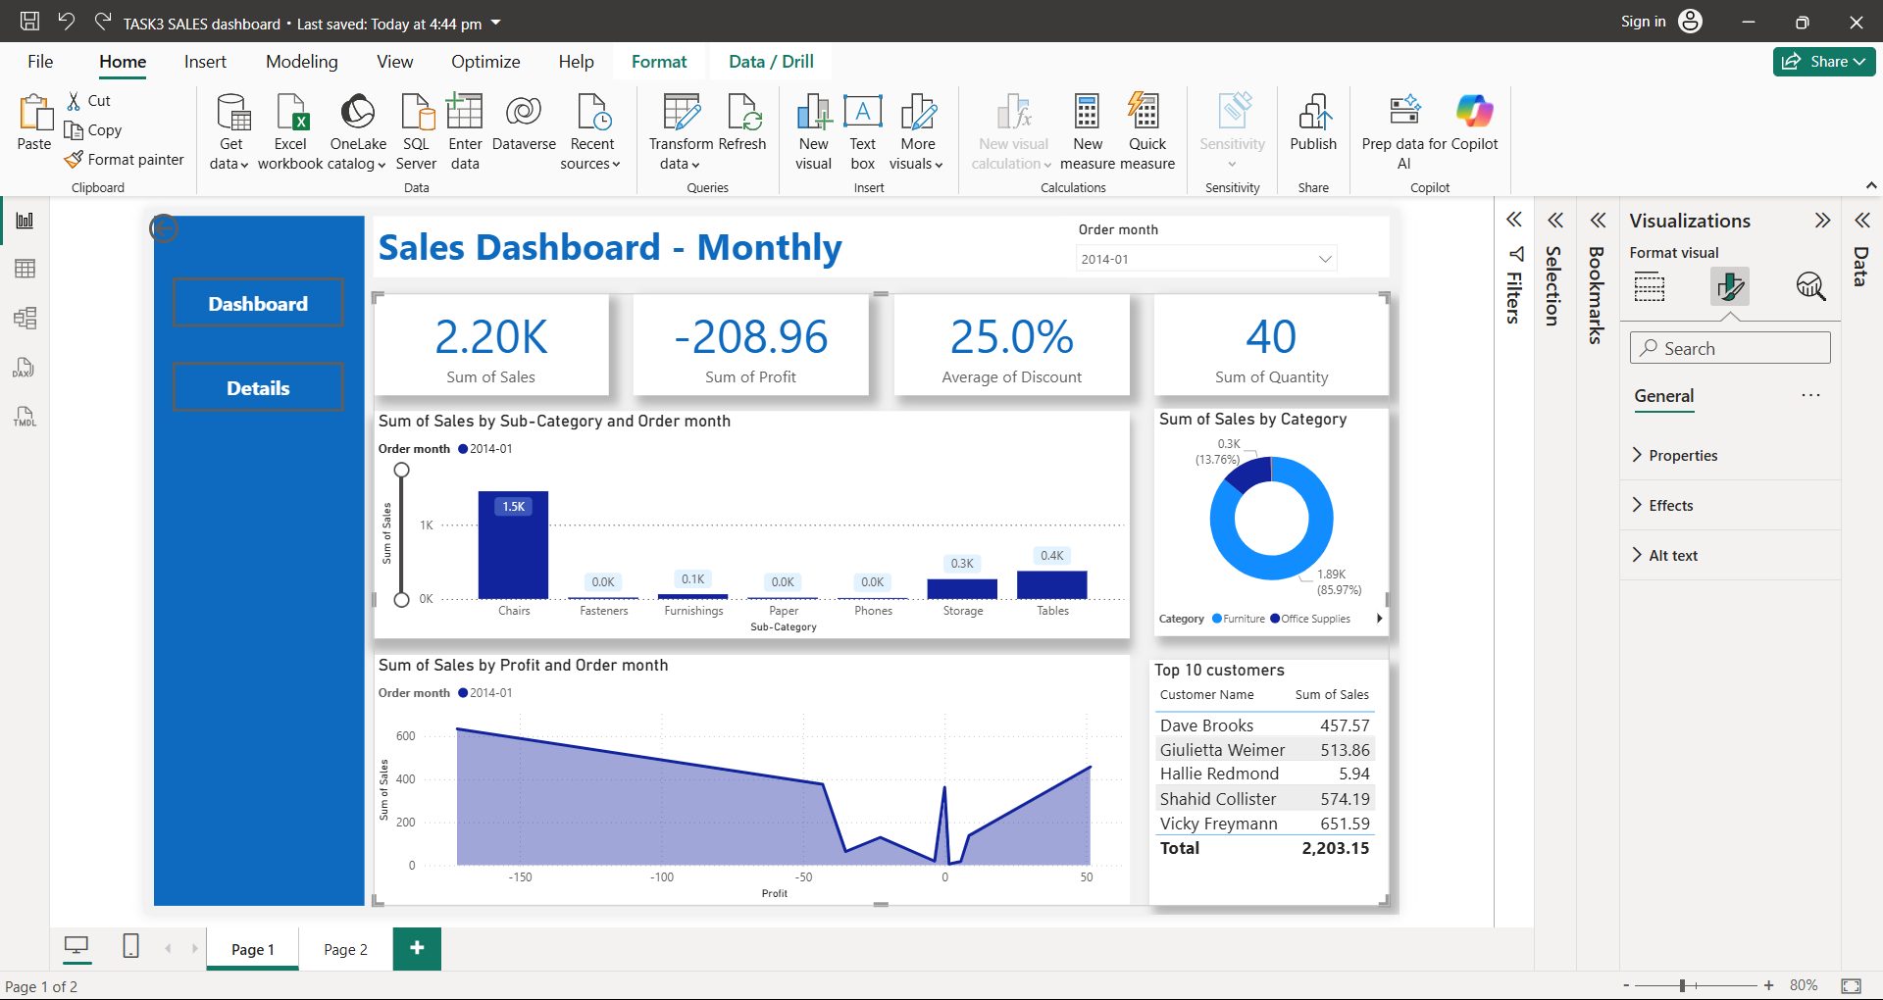
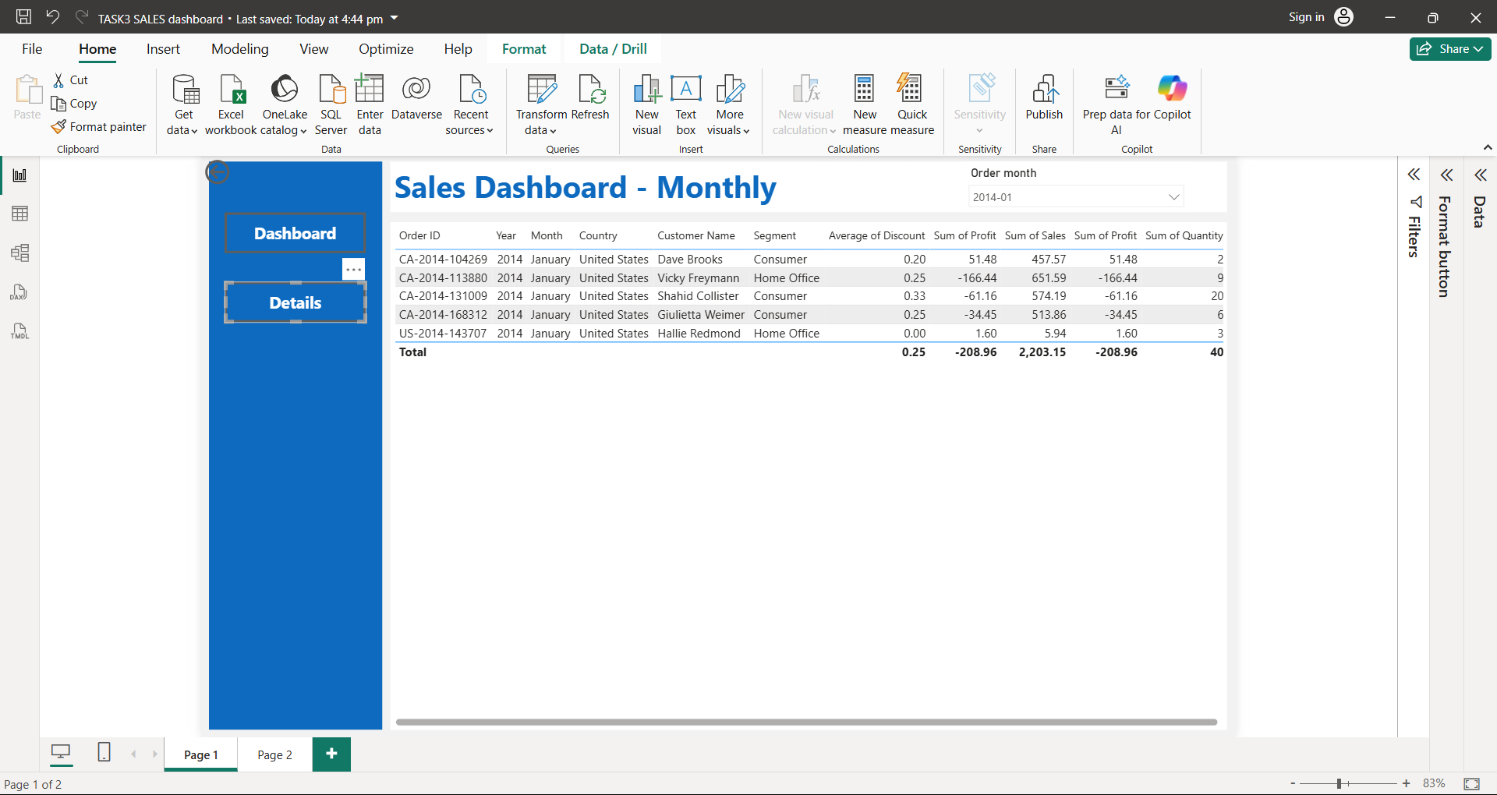
🖼 Power BI Dashboard Preview
(Insert a screenshot of Power BI dashboard here)
This visual showcases the interactive report built using the dataset, highlighting important metrics and drill-down capabilities for better decision-making.

Slide 5
📌 Conclusion
Content:
The Power BI dashboard enables:
Efficient monitoring of key sales performance metrics
Insight into top-performing products and customers
Quick comparison of profit/loss areas
Interactive filtering to analyze trends over time
📈 Outcome:
Learned how to convert raw sales data into meaningful business insights using interactive data visualization in Power BI.

Slide 6
THANK
YOU

